Slide 1
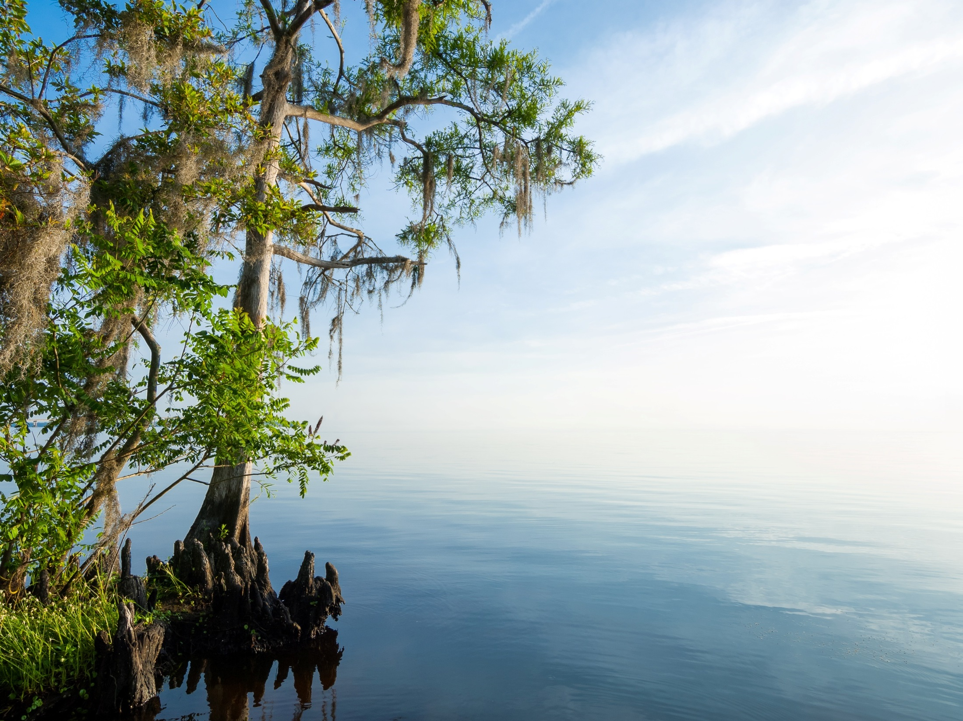
St. Johns River Water Management District
Environmental Resource Permitting Key Environmental Criteria
St. Johns River Water Management District
Notes:
Thank you for inviting me here today to speak with you about the work of the St. Johns River Water Management District. My name is Barbara Hatchitt and I am the supervising regulatory scientist for our Headquarters office in Palatka. I have over 25 years of experience working with the SJRWMD district, and I will be sharing with you today some of the highlights of our regulatory science program. Much like the federal regulatory program, born out of the National Environmental Policy Act, the regulatory program has evolved drastically in Florida over the past 20 years (discuss DER, DEP, and WMD history).
Today we will highlight a four primary areas of our regulatory science program, wetlands & delineation criteria, elimination and reduction of impacts, secondary impacts, cumulative impacts and the public interest test. Before we jump into these topics, I would like to provide you with a brief overview of the SJRWMD.

Slide 2
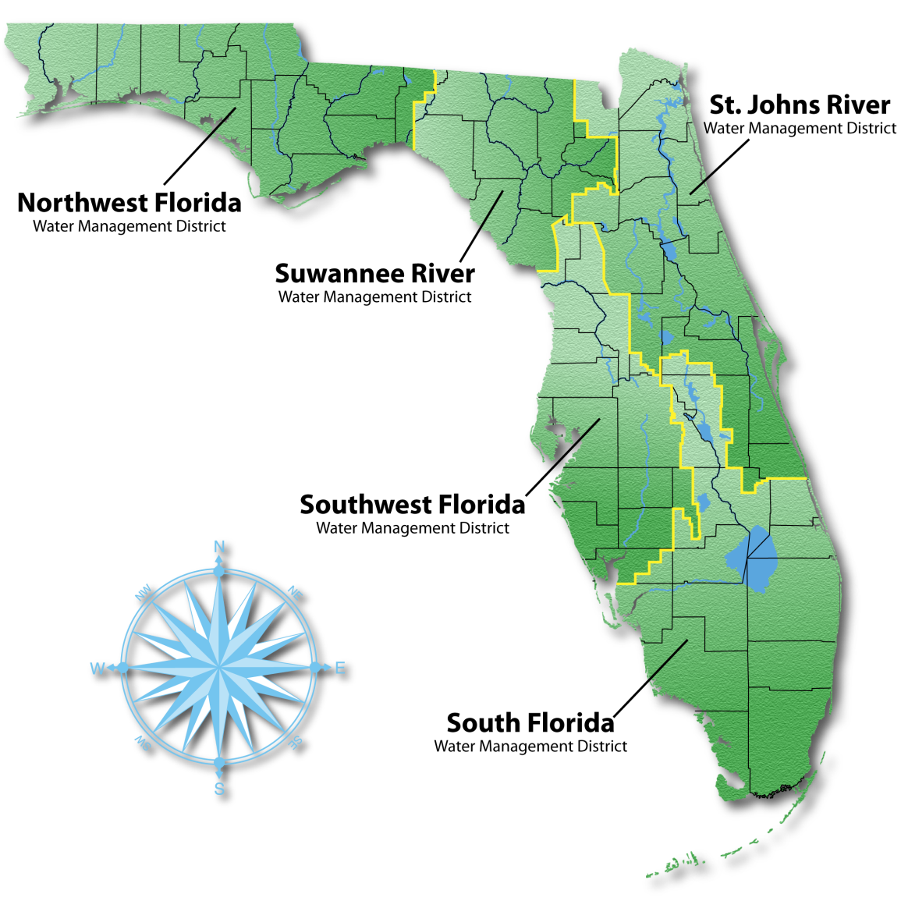
Who We Are
12,283 square miles
Covers all or part of 18 counties in northeast and east-central Florida
.
Notes:
Balancing the water needs of our state’s residents and visitors with the needs of nature is at the heart of the work of Florida’s five water management districts.
The Legislature established the districts in 1972.
Each water management district is governed by a board whose members are appointed by Florida’s governor and confirmed by the Florida Senate. There is also oversight by the Florida Department of Environmental Protection.
The St. Johns District has a nine-member board that oversees the agency, establishes policy, hires the executive director, executes regulatory responsibilities and approves the budget.

Slide 3
Environmental Considerations
Wetland/Surface Waters
Wetland/Surface Waters delineation
Elimination and reduction of impacts
Public interest test
Secondary impacts
Cumulative impacts
Mitigation
Notes:
As mentioned in the opening presentation, we are going to highlight some important aspects of the regulatory science program in today’s lecture. When reviewing a permit application for a project, our regulatory scientists do review additional details and require information beyond these specific factors, but these are the topics we have chosen today, simply because they are some of the most important factors to consider when reviewing a project for permit issuance.
We will stat with a basic discussion of wetlands and the considerations that surround determining a wetland boundary (also known as wetland delineation).
Next, we’ll discuss elimination and reduction of impacts, secondary impacts, cumulative impacts and the public interest test.

Slide 4
Wetlands and Surface Waters
WMDs regulate all isolated and connected wetlands and surface waters (other surface waters: OSW)

Slide 5
Wetlands/Surface Waters Delineation 62-340, F.A.C
Notes:
First let’s discuss the legislative background for defining wetlands in our State. Ratified by legislature as law in section 373.4211, F.S. Then we’ll show and discuss a couple of examples and talk about where these types of wetlands are located throughout the state.
Both Florida and the Federal government have methods to delineate the boundaries of areas considered wetlands although there are differences in the methods that may produce different wetland boundaries in some situations.

Slide 6
Surface Waters / Wetlands
As defined in Florida Administrative Code 62-340
and Florida Statute 373:
“…areas that are inundated or saturated by surface water or ground water at a frequency and a duration sufficient to support, and under normal circumstances do support, a prevalence of vegetation typically adapted for life in saturated soils….(that are) generally classified as hydric or alluvial….(with) prevalent vegetation …(that) generally consists of facultative or obligate hydrophytic macrophytes….”
“Florida wetlands generally include swamps, marshes, bayheads, bogs, cypress domes and strands, sloughs, wet prairies, riverine swamps and marshes, mangrove swamps and other similar areas. Florida wetlands generally do not include longleaf or slash pine flatwoods with an understory dominated by saw palmetto.”
Notes:
Rule intent is to provide a unified statewide methodology (state, water management districts, local governments) for delineation of wetlands and surface waters.
Before implementing the methodology that will be explained the agency “shall identify the wetlands according to the definition.
Identify ectotone
both Florida and the Federal government have methods to delineate the boundaries of areas considered wetlands although there are differences in the methods that may produce different wetland boundaries in some situations. one,
The rule also specifies which areas, i.e., natural pine flatwoods with a saw palmetto understory, which are not generally wetlands.
Effective July 1, 1994
Some types of surface waters have both upland and wetland components
contain no wetland characteristics
are all wetlands

Slide 7
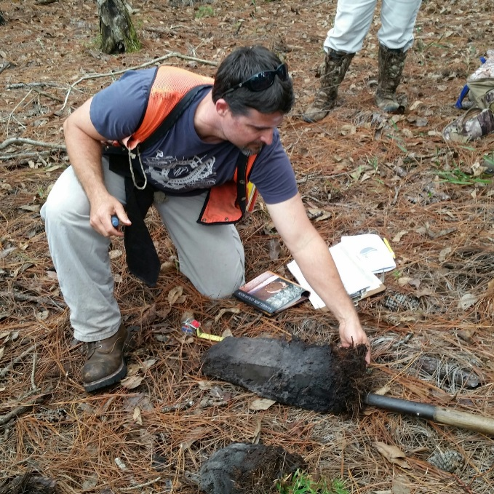
Surface Waters / Wetlands
Important Highlights
To delineate wetlands, use the definition first.
Otherwise, use the methodology 62-340 requires two out of three indicators
Ability to delineate wetlands in altered conditions.
Vegetation lists are slightly different from U.S. Army Corps
Notes:
Here are some primary highlights regarding wetland delineation, and how the State differs slightly from federal delineation technique. (Discuss highlights listed on slide).

Slide 8
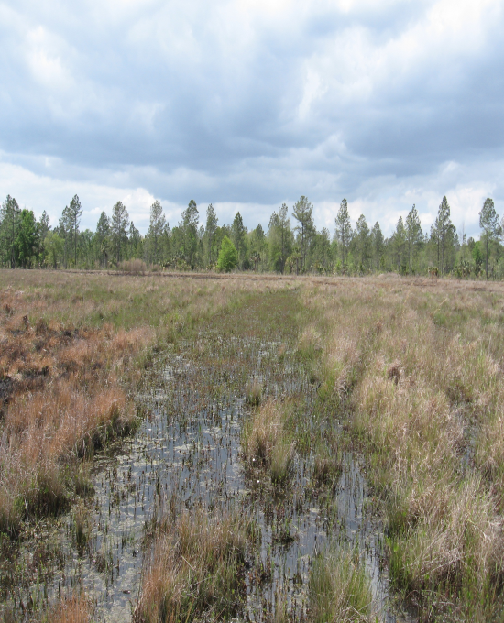
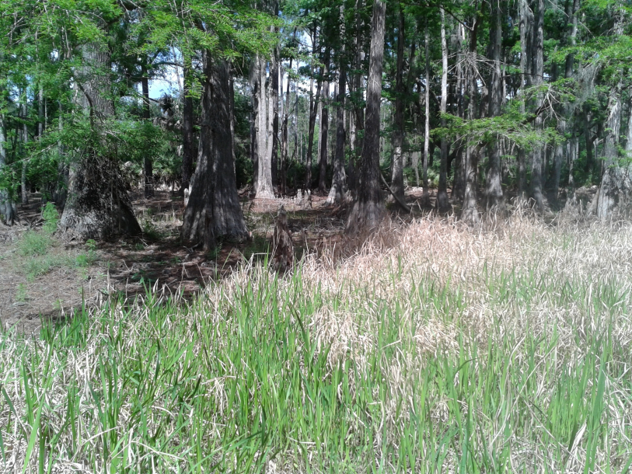
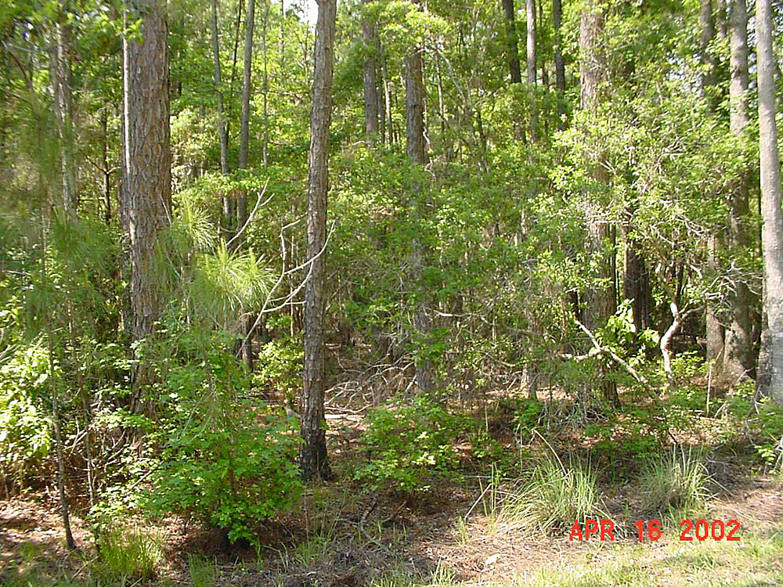
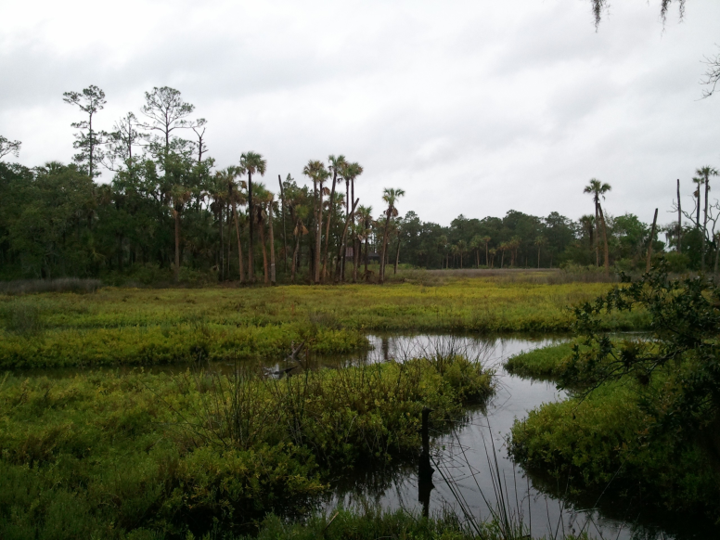
Wetland types
Notes:
Discuss 2-3 examples of types of forested and non-forested wetlands (bayheads, cypress domes, freshwater marsh, hydric pasture).
Discuss many types of agricultural lands are still considered jurisdictional wetlands.
Discuss invasive species and how many systems (especially in southern Florida) are 100% dominated now by species such as Brazilian Pepper and Melaleuca spp.

